Slide 1
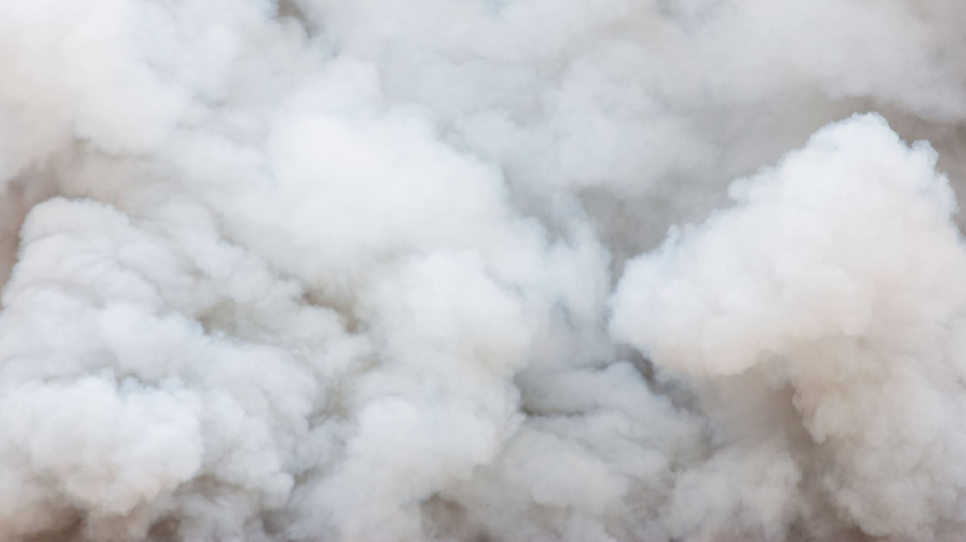
Wildfire Prevalence and Severity
Justin Lawrence, Dustin Malandra, Emilia Roberts, Christ Tanner

Slide 2
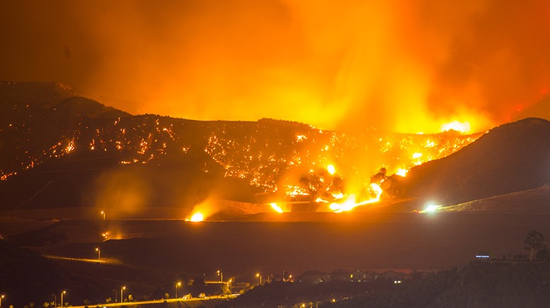
Wildfire background
According to the National Park Service, humans cause around 85% of wildfires annually in the United States, resulting in over 7.5 million acres burned in 2022 [1]
Texas has the highest number of wildfires, Alaska has the most acres burned and California has the most damaging and dangerous wildfires [2]

Slide 3
Project outline
Use data from USDA database for all wildfires from 1992-2020 [4]
Database is already formatted and in SQLite format, allowing for quick interpretation/filtering of data
Contains size, location coordinates, date, established cause and more
Visualize size, prevalence and locations of class D and above (>100 acres burned) wildfires over time course in complete database
Examine most severe fires and what caused them (eg. Lightining strike/human cause)
How humans start forest fires and what can be done to mitigate human started fires

Slide 4
Ethical Considerations
After examining all the data, we determined that there was no personal identifying information. Therefore we had no ethical considerations for actually transforming/displaying that data.
There is an imperative to present data related to dangerous wildfires, especially in places where human created wildfires may be dangerous and destructive to people.

Slide 5
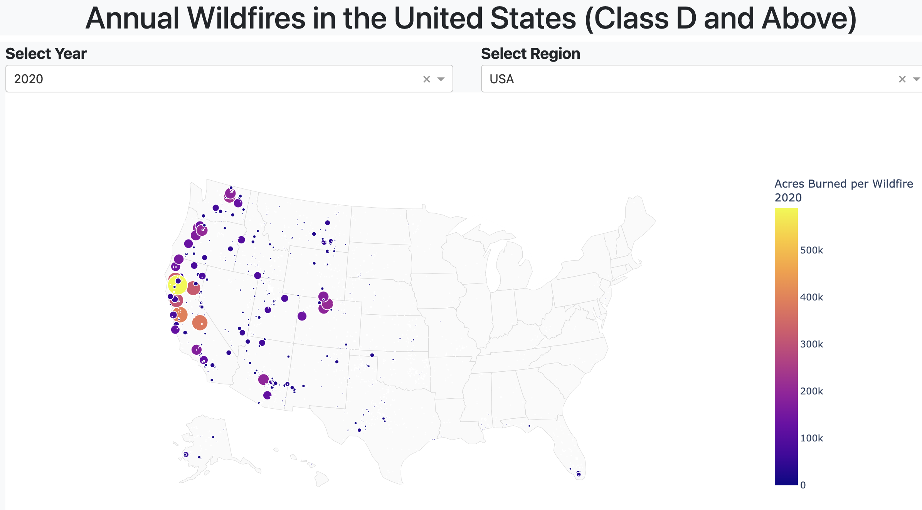
WildFire Locations and Severity (USA)

Slide 6
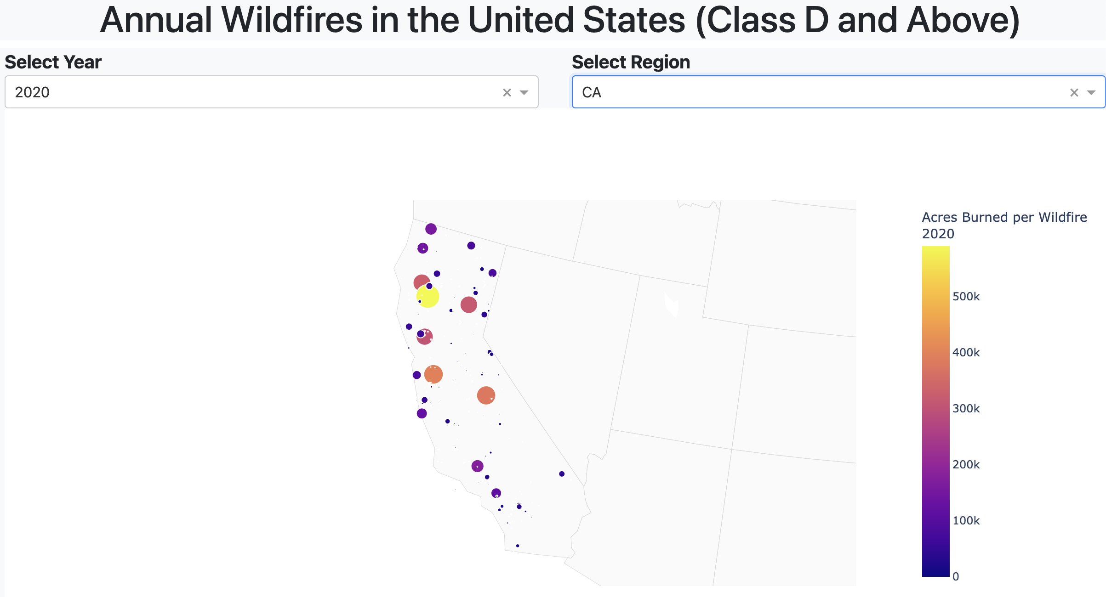
WildFire Locations and Severity (California)

Slide 7
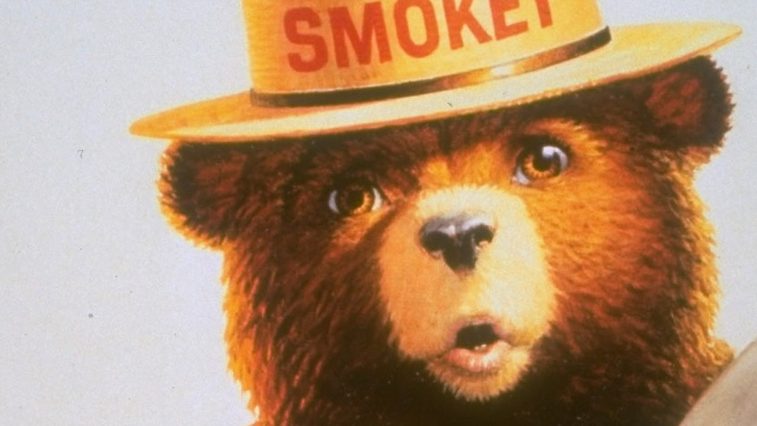
Wildfires by fire code
The USDA categorizes all fires by size in acres (A-G):
A = 0 – 0.25
B = 0.26 – 9.99
C = 10 – 99.9
D = 100 – 299
E = 300 – 999
F = 1000 – 4999
G = 5000+

Slide 8
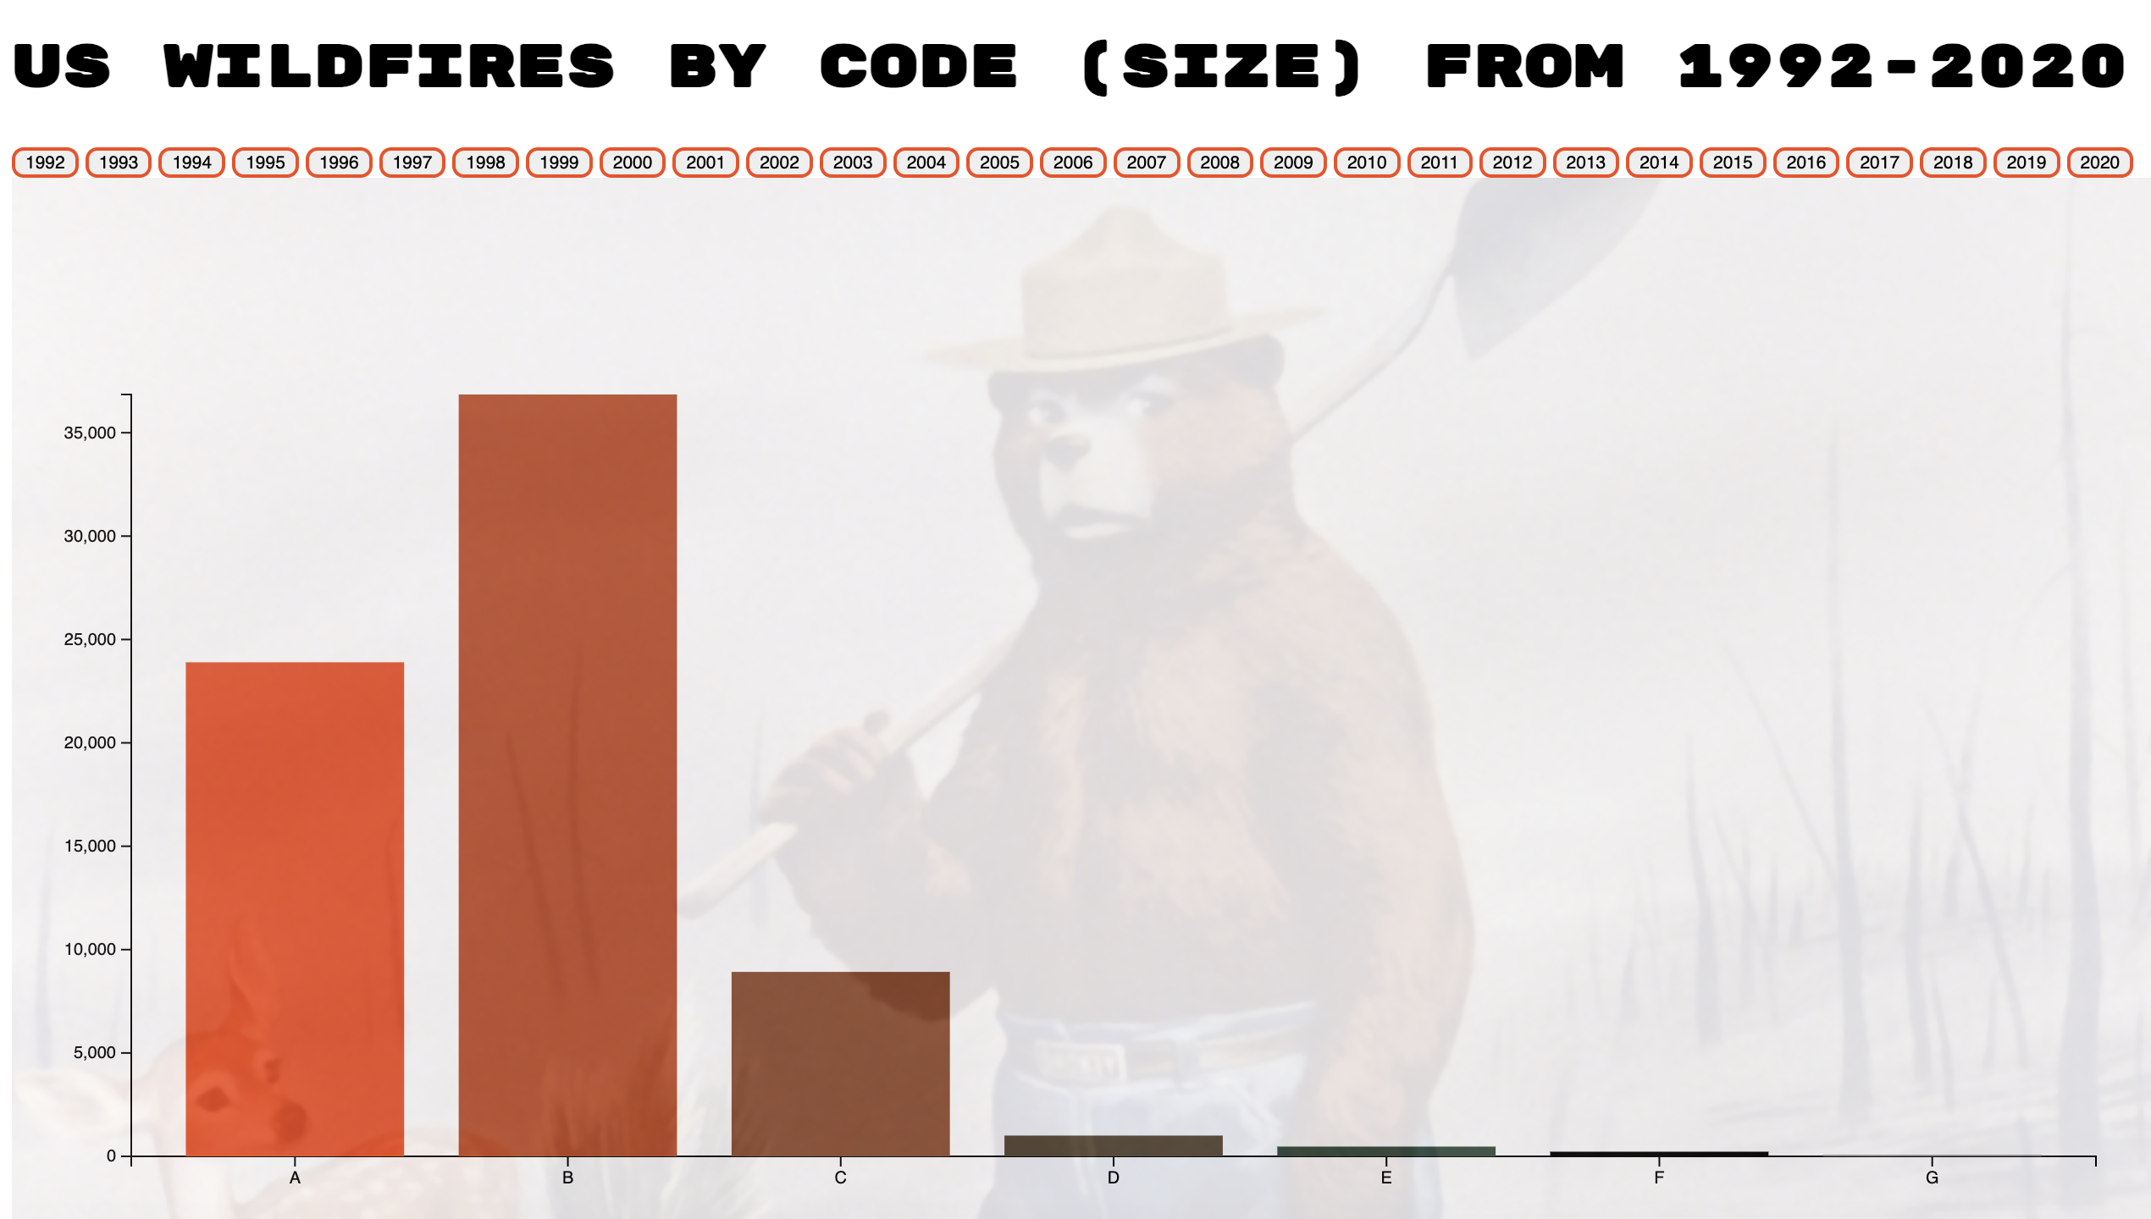
Wildfires by code
The following bar chart represents the total fires in the US by fire size code for a given year.
We can infer from the data some reasons why certain codes dwarf others
Also suggests the vast number of resources allotted towards fire care and prevention every year
https://dmalandra.github.io/animatedchart/

Slide 9
Number and Cause of WildfirES
In this app, we will examine the numbers of wildfires in the United States and their causes.
From this data, we will recommend targeted actions to reduce wildfires.
https://jlawrence16.github.io/wildfire_project/

Slide 10
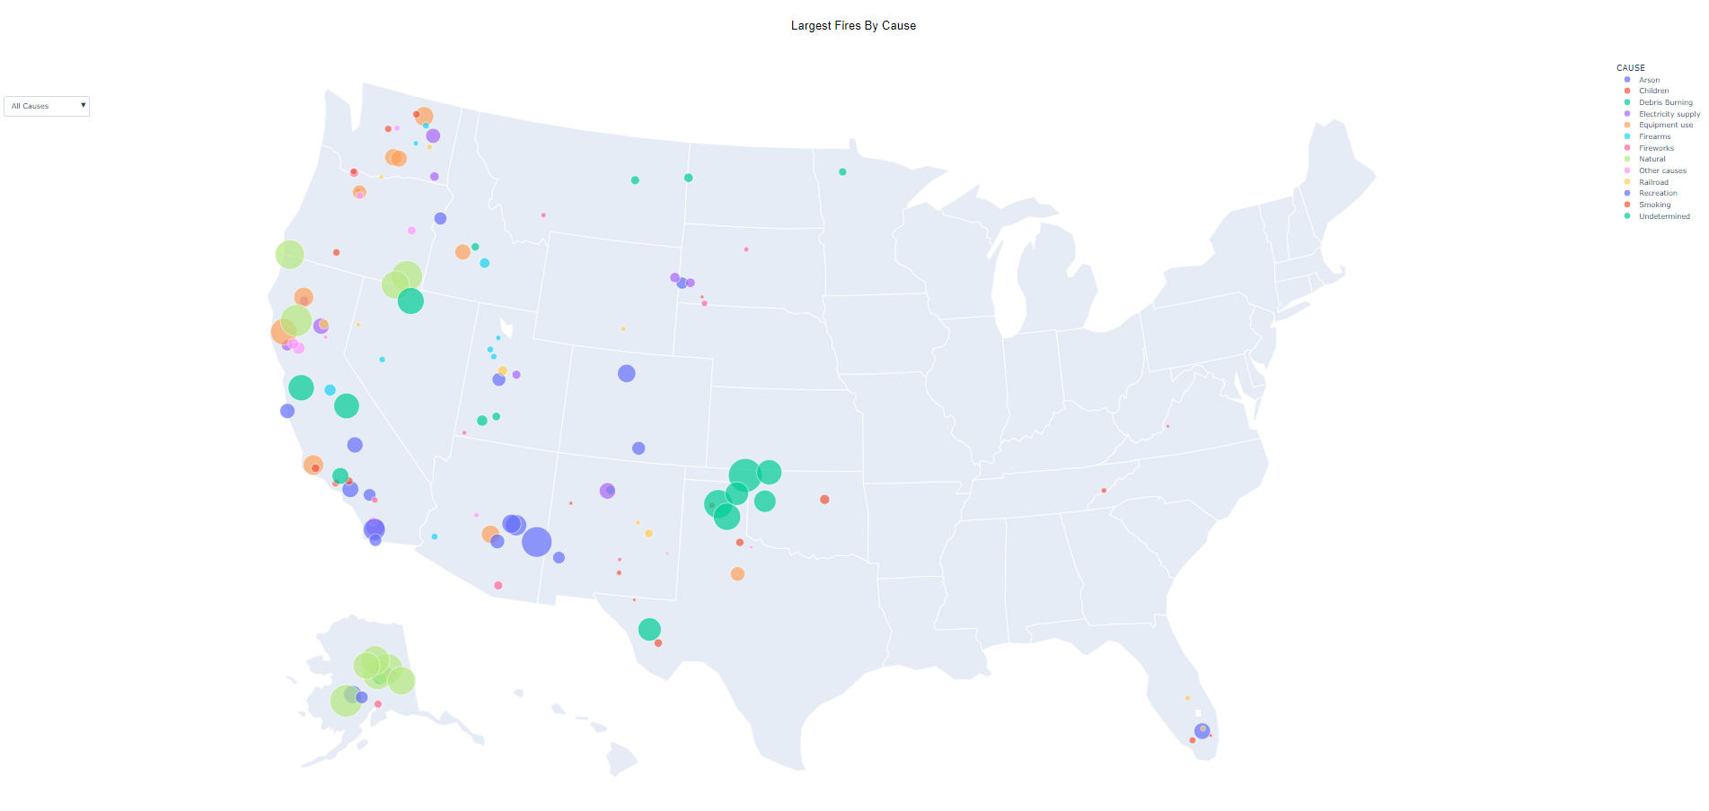
Largest Fires By Cause
10 Biggest Fires Per Cause
Determine Most Severe Causes
Map
Causes:
Arson, Children, Debris Burning, Electricity Supply, Equipment Use, Firearms, Fire Works, Natural, Other, Railroad, Recreation, Smoking, Undetermined

Slide 11
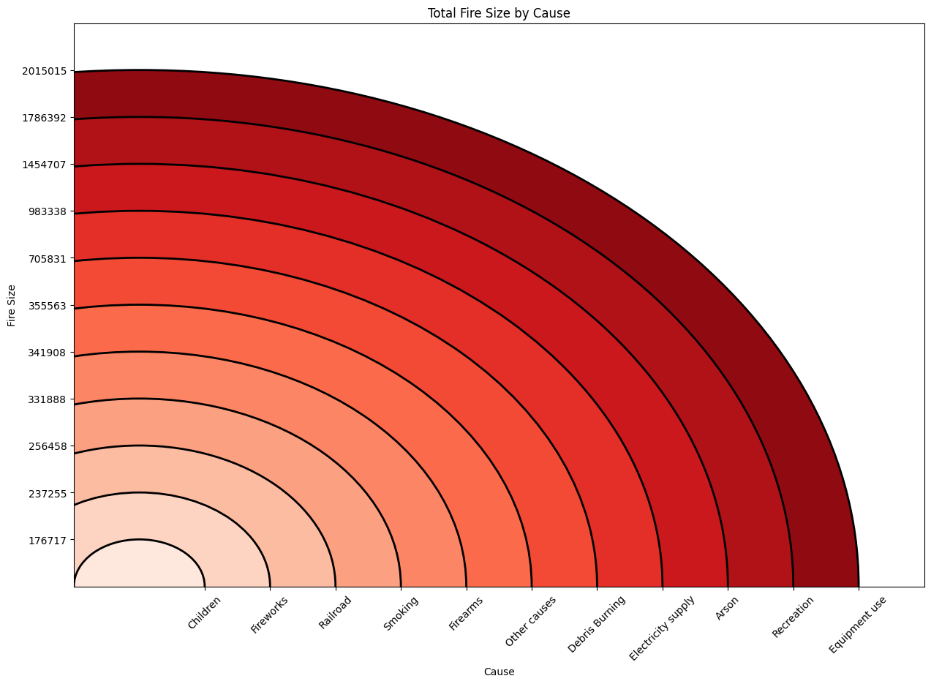
Most concerning Causes

Slide 12
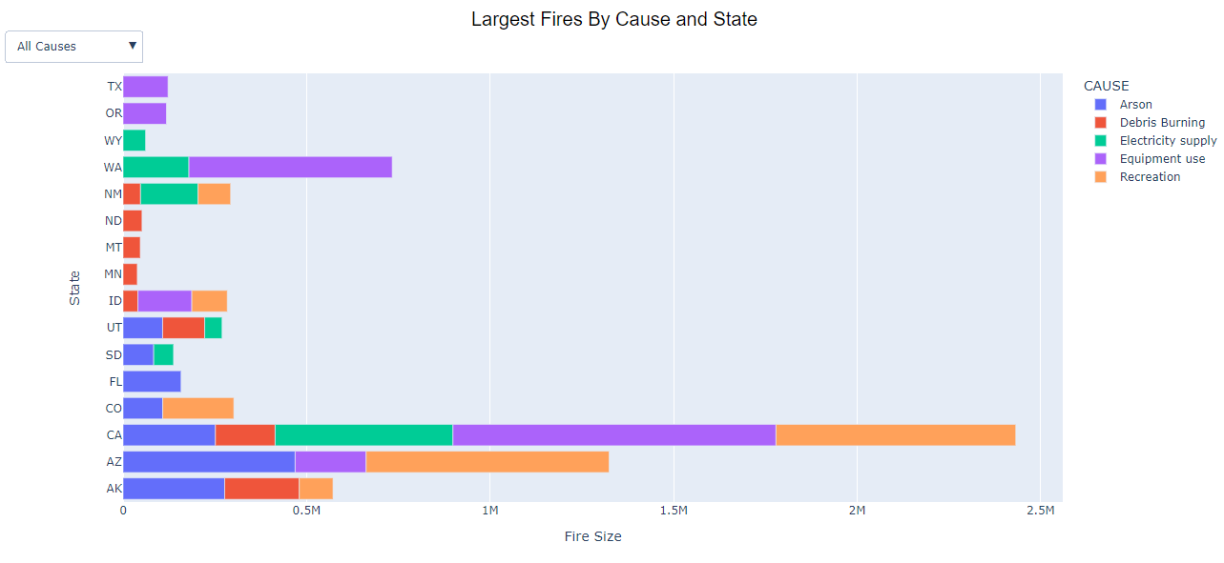
State by State Concerns
Impact on each state
State’s focus on prevention
Graph

Slide 13
State By state Summary
Arson
Arizona: 468,863
Florida: 158,000
Debris Burning
Alaska: 203,250
Utah: 114,474
Electricity Supply
California: 484,489
New Mexico: 156,593
Equipment Use
California: 880,061
Washington: 553,937
Recreation
Arizona: 661,924
California: 653,322

Slide 14
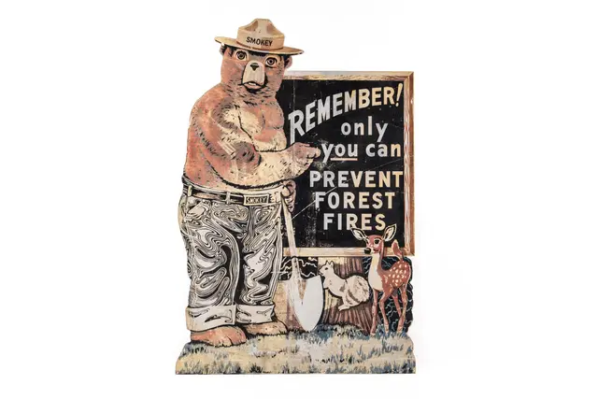
Prevention
Arson [5]
Report suspicious behavior
Secure Home
Remove Flammable Outdoor Items
Bags of Leaves, Overnight Hanging Laundry
Debris Burning [6]
Check Conditions
Windy or Vegetation is dry
Check Above
Powerlines, overhanging branches, buildings
Stay with fire until gone
Electricity Supply [7]
Burying Power Lines
Check existing powerlines
Weather may cause lines to sag and touch tree or dry grass

Slide 15
Prevention
Recreation
Check Conditions
Windy or Vegetation is dry
Check Above
Powerlines, overhanging branches, buildings
Stay with fire until gone
Fire extinguisher available
Equipment Use
All vehicles up to code
Dragging parts, secure chains, tire pressure
Regular checks for flaws
Safety Training

Slide 16
References
[1] https://www.iii.org/fact-statistic/facts-statistics-wildfires
[2] https://www.nifc.gov/fire-information/fire-prevention-education-mitigation/wildfire-prevention
[3] https://www.nwcg.gov/sites/default/files/data-standards/pdf/values.pdf
[4] https://www.fs.usda.gov/rds/archive/catalog/RDS-2013-0009.6
[5] https://www.somervillema.gov/news/arson-prevention-tips-and-fire-safety
[6] https://smokeybear.com/en/prevention-how-tos/backyard-debris-burning
[7] https://www.fastcompany.com/90945794/power-lines-and-wildfires-why-the-decision-to-shut-off-power-is-more-complicated-that-youd-think#:~:text=There%20are%20a%20lot%20of,touch%20dry%20grass%20or%20trees.

